Slide 1

Intrinsic Transport Properties & Scattering Mechanisms in TMDs
Dept. of Physics & Astronomy
Kraig Andrews
Nanofabrication & Electron Transport Laboratory

Slide 2
Overview
Motivation
Introduction
Device Fabrication
Preliminary Results
Future Work & Conclusion

Slide 3
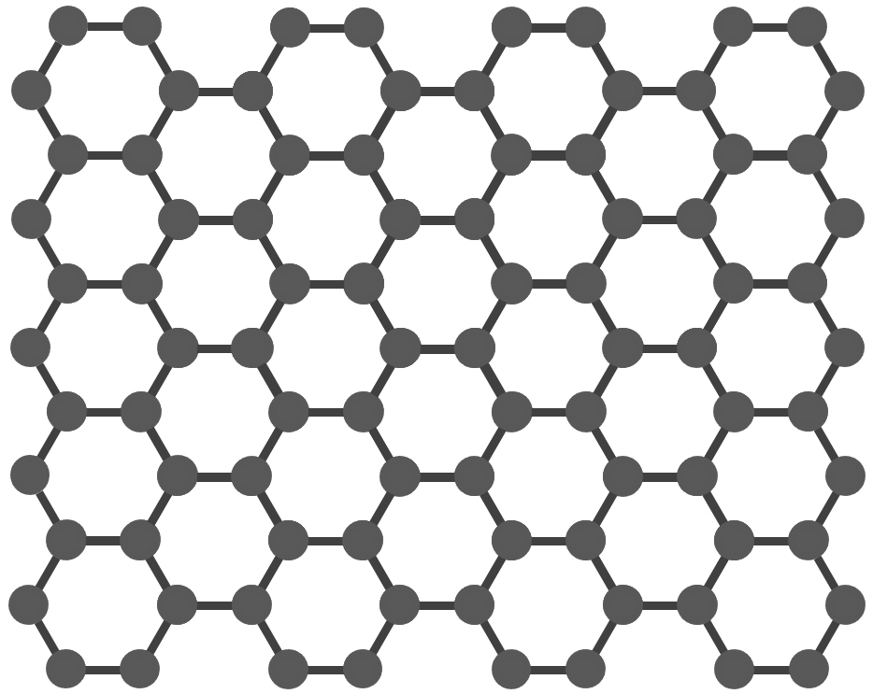
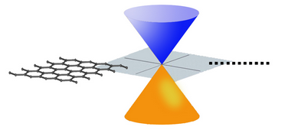
Graphene
High mobility
10⁴ cm²V⁻¹s⁻¹ at T_{room}¹
Upper limit 10⁵ cm²V⁻¹s⁻¹ at T_{room}²
High Young’s Modulus
No Bandgap³
Low I_{on}/I_{off} ratio
Notes:
-First monolayer synthesized in 2004 (Novoselov et al.).
-Mobility is an order of magnitude larger than Si. Upper limit is for suspended graphene (i.e. removed substrate).
-Extremely strong material, stronger than steel.
-Conduction and valence bands touch -> no band gap -> low on/off ratio -> not usable for logic circuits

Slide 4
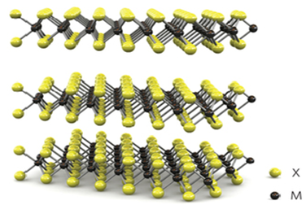
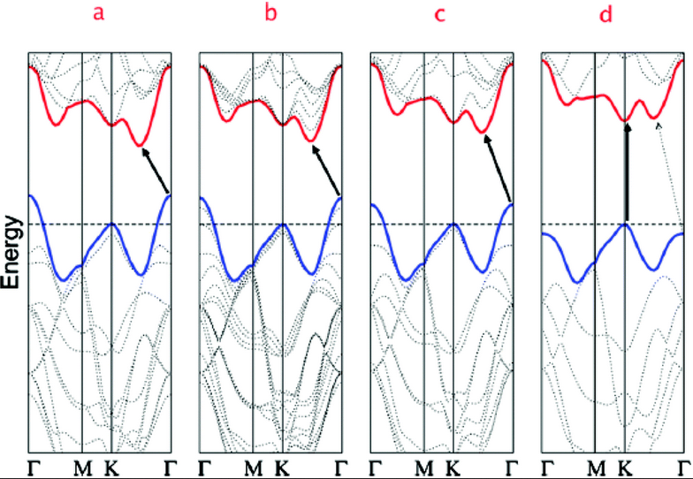
TMDs
Transition Metal Dichalcogenides (TMDs)
Transition Metal Chalcogen
Mo, W, V S, Se, Te
MX₂
(MoS₂, MoSe₂, WSe₂, WS₂)
Unique Band structure³
Extremely Strong
High I_{on}/I_{off} ratio > 10⁶
Notes:
-High on/off ratio
-Bandgap exists -> can be used for logical circuits
-Band structure for (a) bulk MoS2, (b) four-layer MoS2, (c) bi-layer MoS2, and (d) Monolayer MoS2.
-Shows transition from indirect bandgap to direct bandgap. Arrows indicate the lowest energy transitions.
-Strong/flexible materials

Slide 5
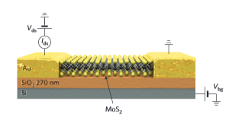
Field Effect Transistors (FETs)
Si/SiO₂ substrate
TMD channel
Ti/Au electrodes
Source Channel Drain
Notes:
-Example of FET on Si/SiO₂ substrate w/ TMD channel (MoS₂ here).

Slide 6







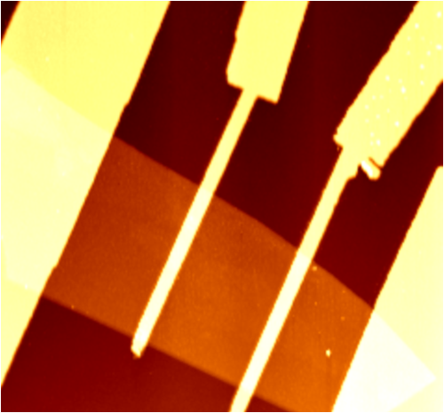
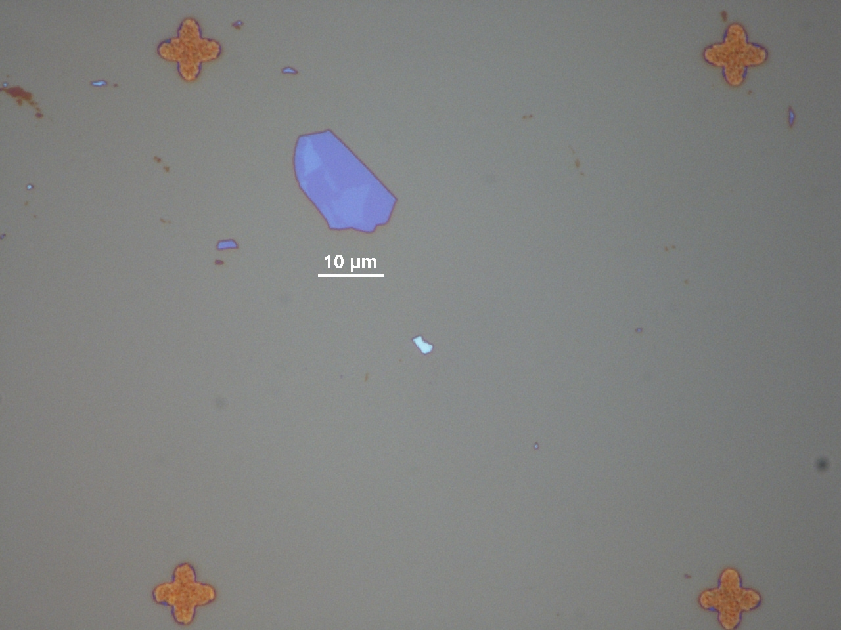
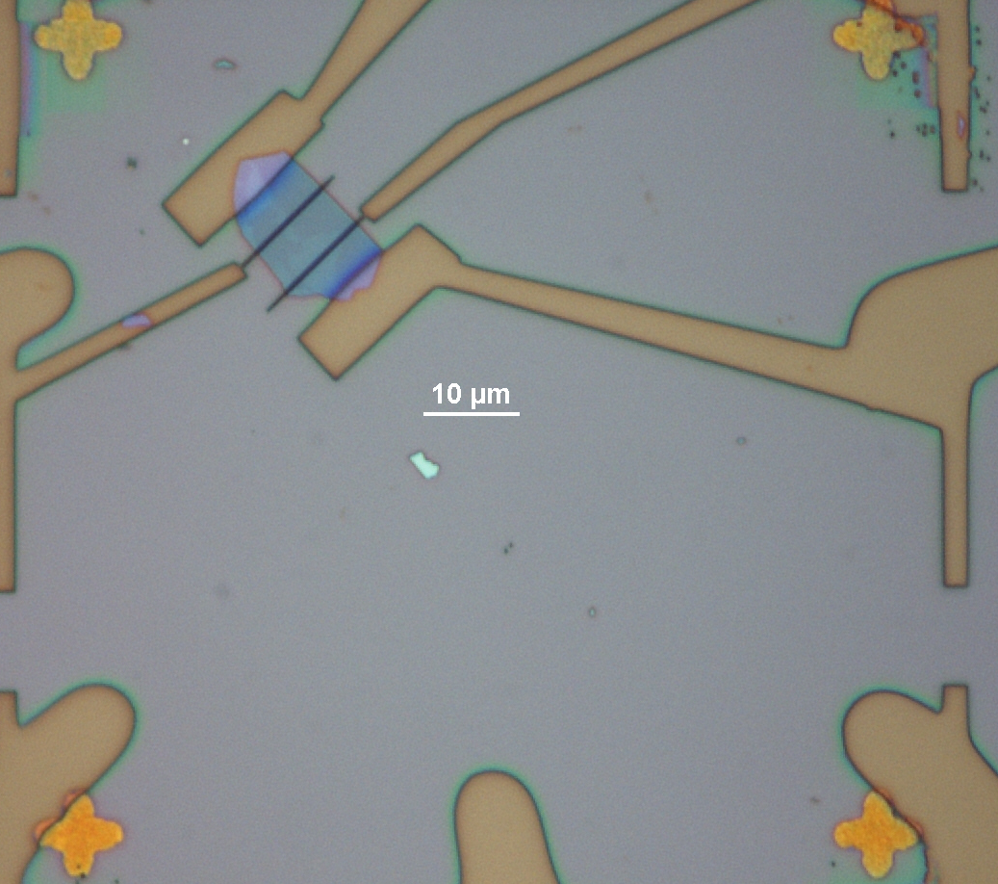
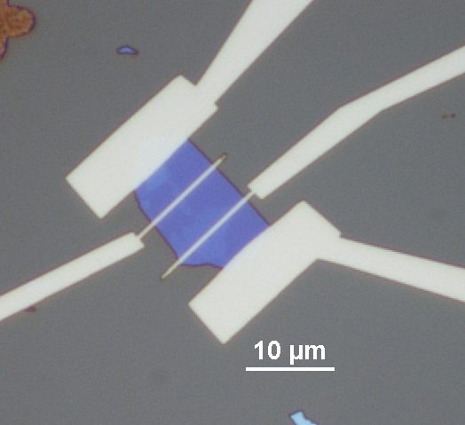
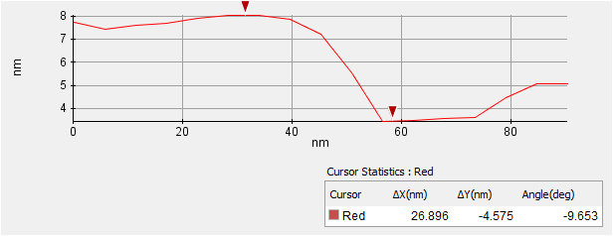
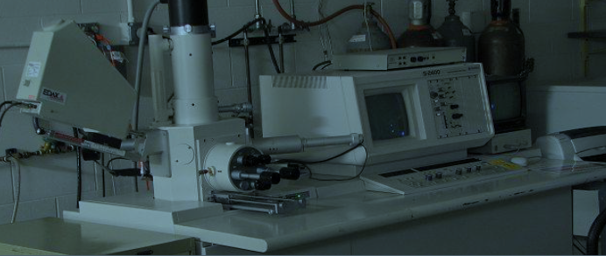
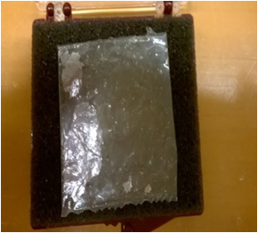
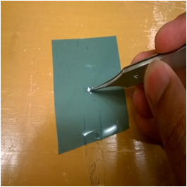
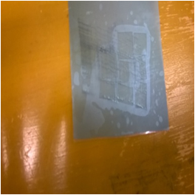
n
Device Fabrication Process
SiO₂ on Si p-type substrate
SiO₂
Exfoliation of TMD
n+
n+
Electron Beam Lithography
Ti/Au Metal Deposition
AFM Characterization
p-type Si
Developed Electron Beam Lithography Pattern 100x
MoS₂ on Substrate
Lift Off
Bulk MoS₂ Crystal
MoS₂ Flake
Exfoliated MoS₂
Notes:
-Start with SiO₂ on Si substrate
-Mechanical Exfoliation of TMD using Scotch tape method. Transfer TMD to substrate
-Design pattern for EBL. Spin-coat with PMMA. Write pattern. Develop. (Example of four-probe device)
-Deposit Ti/Au using metal deposition in clean room
-AFM characterization to get height profile, length of channel, width, cleanliness, etc…

Slide 7
Challenges
Contact Resistance
Schottky barrier
Scattering mechanisms
Understand impact on mobility
Study p-WSe₂ doping effects
Impurities & mobility degradation
Performance limits
Device applications
Notes:
Determine how to best ‘tune’/reduce SB.
Understand scattering mechanisms and how the mobility is affected
How doping affect mobility (i.e. degrades it, but by how much). Needed for device applications.
p and n type doping both important to applications. Both sides needed for CMOS, etc…
Understand room temp. limits on mobility and how these values can be improved.

Slide 8
Mobility & Scattering
How to measure FET performance?
Mobility μ
μ limited by scattering:
Optical phonons
Acoustic phonons
Interface scattering
Impurities/channel defects
Intrinsic
Extrinsic
Study these mechanisms & how they effect device performance
Notes:
FET performance measured by mobility (or carrier density)
Intrinsic scattering:
Optical phonons, Acoustic phonons: high T more phonons → more phonon scattering
Extrinsic scattering:
Interface scattering, roughness scattering: reduced by using hBN substrates
Coulomb scattering, doping introduces impurities → degrades mobility.

Slide 9
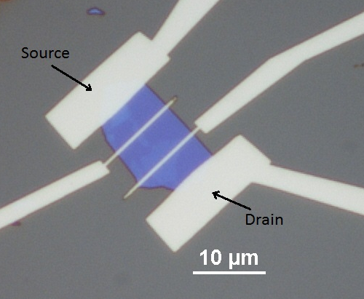
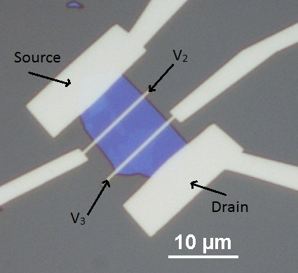
Field-Effect Mobility μ_{FE}
Two-probe R_{c} affected
Four-probe R_{c} subtracted
Notes:
Two-probe measurement. Affected by contact resistance.
Four-probe measurement. Contact resistance subtracted. Voltage drop across V₃ → V₂ measured
Capacitance is geometrical

Slide 10
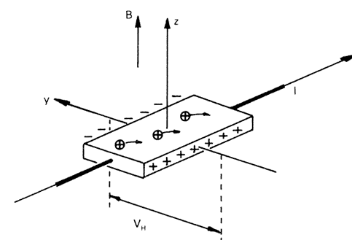
Hall Mobility μ_{H}
μ_{H}
Conductivity
Carrier density
μ_{RT} ~ 10-10² cm²V⁻¹s⁻¹
-Doped WSe₂
μ_{Low-T} ~ 10⁴ cm²V⁻¹s⁻¹
-MoS₂
Notes:
Hall mobility one mobility used to characterize devices.
-Current in the +x direction (→ E_{x}), B-field in +z direction, carriers deflected to side of device.
-Accumulation of charges one side → creates transverse E_{y} → potential difference → Hall voltage → Hall coefficient R_{H}=1/ne
-When transverse conductivity σ_{xy}≠ 0 (ρ_{xy}≠ 0), σ_{xx} → 0 (ρ_{xx} → 0)

Slide 11
Temperature Dependence of μ
High Temperature
Phonon scattering dominated
T , μ
Low Temperature
Diminished phonon scattering
Coulomb, impurity, interface, defects dominated
T , μ
Notes:
-At high T, mobility is dominated by phonon scattering.
-μ should decrease as T increases.
-At low T:
-Coulomb scattering, interface (roughness), doping defects (if any) can degrade mobility at low T
-However, in general as T decreases, μ should increase

Slide 12
Contacts/SB
Low contact resistance desired for applications
Schottky barrier (SB)
Fermi level mismatch at metal/semiconductor interface
How to reduce SB height and width
Metal work functions
Graphene contact interface
Notes:
-Large R_{c} at room temp. is bad for device applications → low room temp μ_{FE}
-SB develops: Difference between Fermi levels at metal/semiconductor interface
-Ways to reduce SB:
-Match metal work functions, but hard to do, and if successful, effect minimized due to Fermi level pinning (i.e. Energy states develop within band gap
causing Fermi level to be pinned)
-Use graphene contacts as a way to tune SB

Slide 13
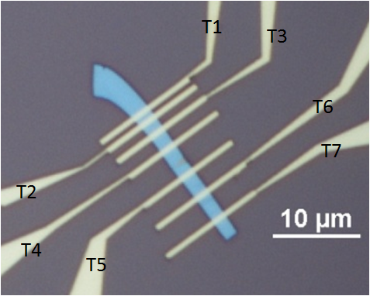
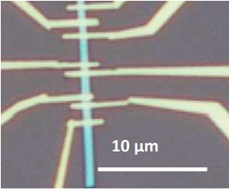
Approach
2D/2D Contacts
Contact Resistance
Nb_{0.0005}W_{0.9995}Se₂
Doping Lower SBH
Nb_{0.005}W_{0.995}Se₂¹
Notes:
-Another approach: use 2D/2D contact method
-Degenerately doped contacts to reduce SB width. Higher doping -> lower contact resistance
-Use Transmission Line Method (TLM) to find R_{c.}

Slide 14
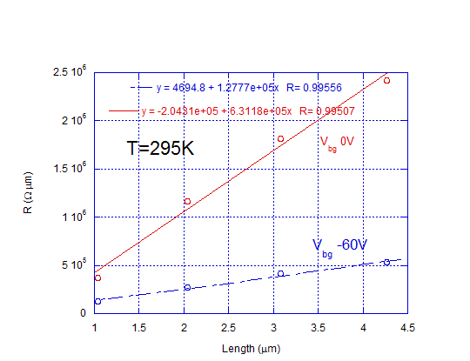
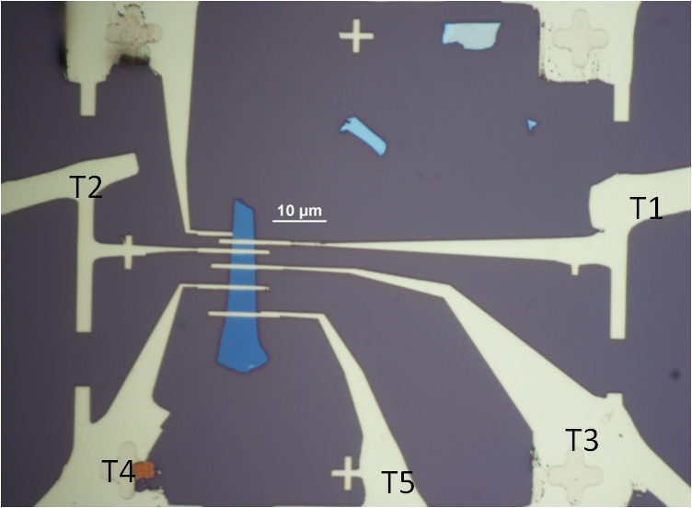
Nb_{0.0005}W_{0.9995}Se₂ (0.05%)
Nb_{0.0005}W_{0.9995}Se₂
Notes:
-Lightly doped WSe₂
-Find contact resistance as a function of length. Then fit it to linear line to get y-intercept.
-Then y-intercept divided by 2 is the contact resistance.
-Here R_{c} = 2.35 kΩ µm

Slide 15
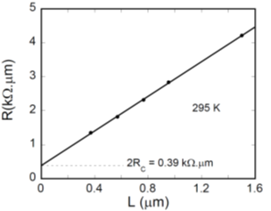
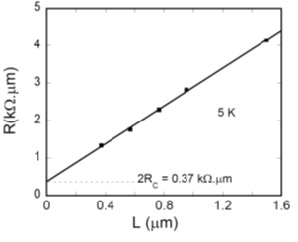
Nb_{0.005}W_{0.995}Se₂ (0.5%)
Nb_{0.005}W_{0.995}Se₂¹
Notes:
-Degenerately doped WSe₂
-Using TLM measurement
-Room temp measurement R_{c} = 0.195 kΩ μm
-T=5 K measurement R_{c} = 0.185 kΩ μm
-Low R_{c} at Low T → good low barrier and good contacts

Slide 16
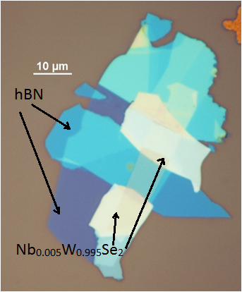
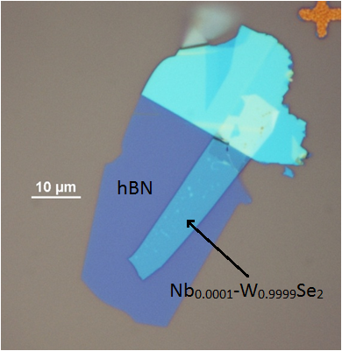
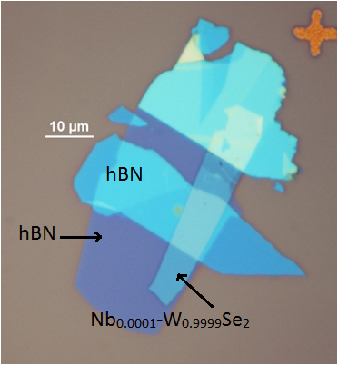
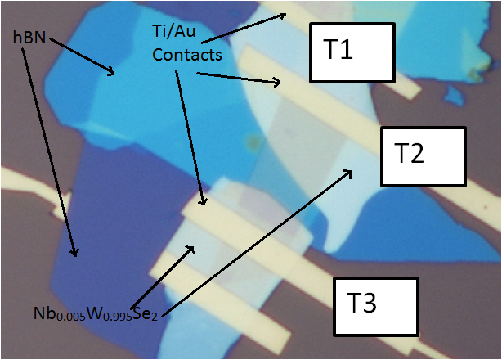
2D/2D Contacts Device Fabrication
Notes:
-Employ 2D/2D contacts strategy to fab device.
-Use hBN substrate to reduce interface/roughness scattering
-Transfer WSe₂ device channel on top
-Transfer hBN to cover channel to reduce any extrinsic effects
-Transfer Nb-WSe₂ contacts and fabricate electrodes

Slide 17
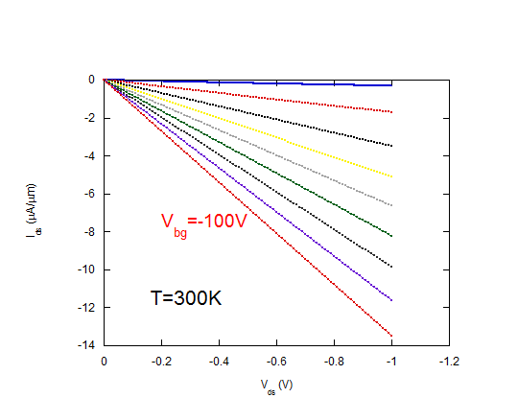
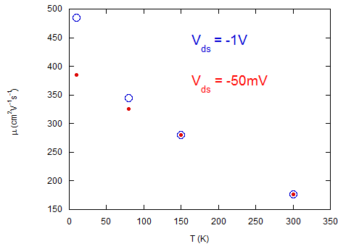
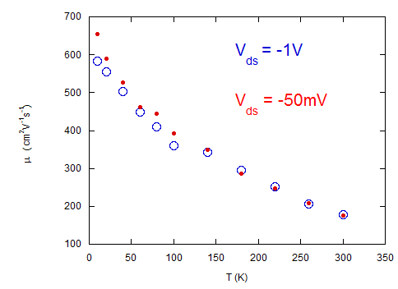
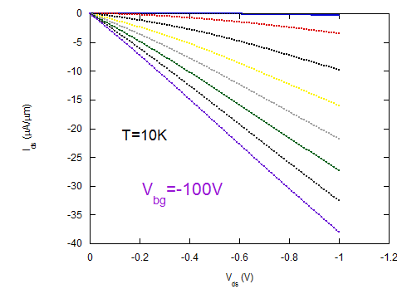
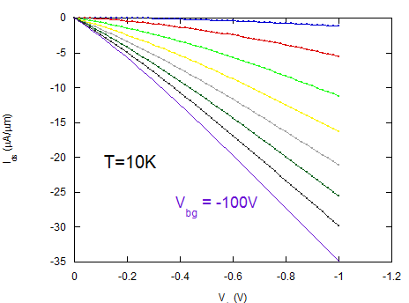
2-Probe μ_{FE} Doped Contacts (0.5%)
Doped Channel (0.01%)
Before annealing at 250º C for 30 min.
After annealing at 250º C for 30 min.
Nb_{0.0001}W_{0.9999}Se₂ Channel & Nb_{0.005}W_{0.995}Se₂ Contacts
Notes:
-Light doped contacts and lightly doped channel (both w/ Nb-WSe₂)
-IV characteristic at T=300K for various V_{bg}, linearity → Ohmic contacts
-IV at T=5K for various V_{bg}, loss of linearity at low temperature → loss of ohmic behavior → some barrier developed
-Field-effect mobility as a function of T. Mobility degraded at low T, due to barrier
-IV curves at T=300K and T=5K, after annealing → removed some residue or something that caused contact issue → ohmic contacts at RT and Low T
-Improved mobility at Low T

Slide 18
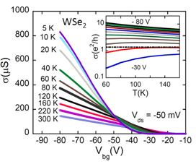
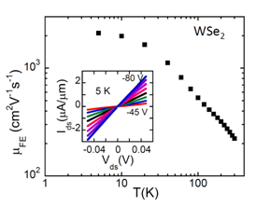
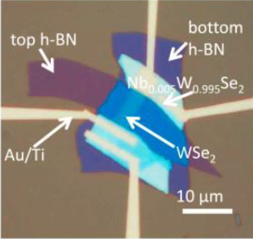
2-Probe μ_{FE} Doped Contacts (0.5%)
Undoped Channel
Undoped Wse₂ Channel & Nb_{0.005}W_{0.995}Se₂ Contacts¹
Notes:
-Compare previous with undoped WSe₂ channel and degenerately doped Nb-WSe₂ contacts
-Conductivity as a function of Vbg for various temperatures. Increased conductivity with increased Vbg and increases with decreased temperature.
-Expected behavior.
-Inset shows low temperature IV curves with ohmic contacts
-Field-effect mobility as a function of temperature shows an order of magnitude mobility larger than previous slide’s device.
-Shows channel doping degrades mobility, and higher doped contacts improves low temperature mobility

Slide 19
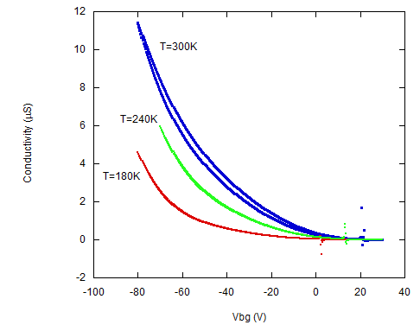
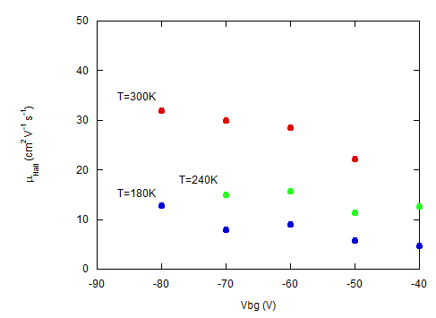
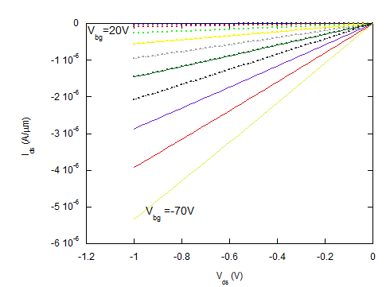
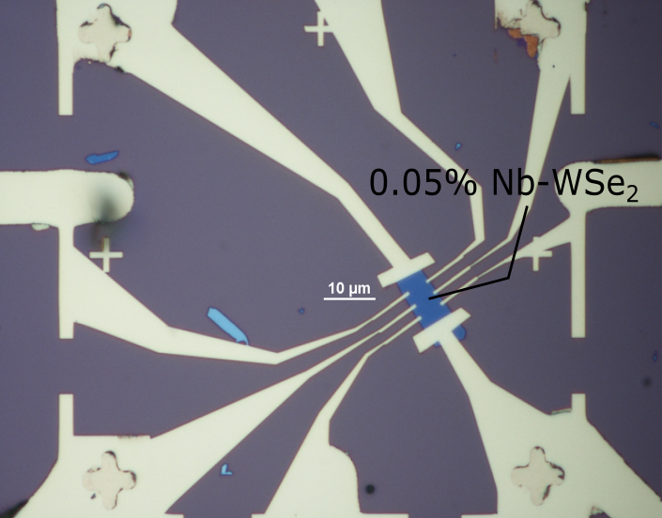
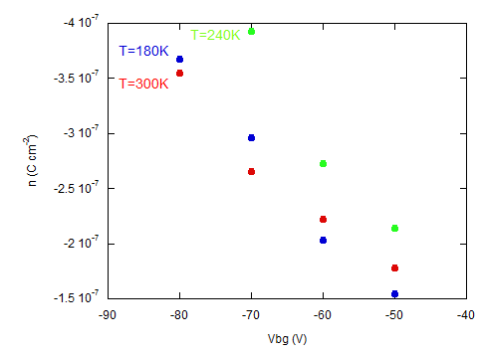
Nb_{0.0005}W_{0.9995}Se₂ μ_{H}
Nb_{0.0005}W_{0.9995}Se₂ Doped Channel
Notes:
-Lightly doped Hall bar device
-Shows room temperature IV curve (ohmic at T=300K, at least)
-Conductivity as a function of Vbg for various temps.
-Trend shown is opposite of what is expected → barrier has developed
-Hall mobility as a function of Vbg for various temps.
-Opposite of expected behavior → screening/Coulomb scattering and impurity scattering here at lower T, and phonon scattering at higher T
-Charge carrier density as a function of Vbg for various temps.
-Expect linearity and along (relatively) same line.
-Slope gives capacitance, should be similar for all temps.

Slide 20
Quantum Transport
Integer Quantum Hall Effect (IQHE) & Shubnikov-de Haas (SdH) oscillations
Low Temperature (< 4K)
High Magnetic Field (~10 T)
High µ at Low T Required

Slide 21
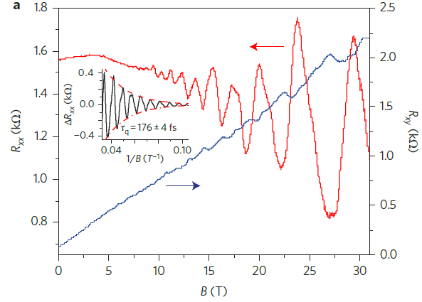
SdH & IQHE in MoS₂
τ_{q-MoS2-1L} = 0.18 ps⁵
τ_{q-BP-10nm} = 0.12 ps⁶
Device quality
Cyclotron effective m
m_{electrons,} m_{holes}

Slide 22
Performance Limits
Theoretical 1L mobility at T=295K⁷
~320-410 cm²V⁻¹s⁻¹
Experimental mobility at T=295K⁸
~200 cm²V⁻¹s⁻¹
I_{on}/I_{off} > 10⁷, I_{on} ~ 300 μA/μm
How to close theoretical/experiment gap

Slide 23
Summary
2D/2D contact strategy to lower R_{contact}
Improve μ through hBN encapsulation
Determine quantum properties using low T and high B environment
Room T performance limits

Slide 24
Acknowledgements
The authors would like to acknowledge:
Nanofabrication and Electron Transport Laboratory students:
Hsun Jen Chuang, Bhim Chamlagain, Meeghage Madusanka Perera, Arthur Bowman III, Upendra Rijal, and Sagar Paudel
Committee Members: Dr. Zhixian Zhou,
Dr. Jian Huang, Dr. Ashis Mukhopadhyay, Dr. Mark Cheng

